Slide 1
HR0372
National and organisational cultures

Slide 2
An analysis of the culture of an organisation
Assignment requires you to
  apply ONE theoretical framework used in the study of organisational culture to the analysis of an organisations’ culture

Slide 3

Assignment requires you to apply a theoretical framework used in the study of organisational culture to the analysis of an organisations’ culture
Watch the film clip/ video and then identify the culture being depicted using Hofstede’s cultural dimensions
  http://www.apple.com/jobs/uk/retail.html
  Complete the task sheet provided as you watch the film clip

Slide 4
Assignment requires you to apply a theoretical framework used in the study of organisational culture to the analysis of an organisations’ culture
Watch the film clip/ video and then identify the culture being depicted using Hofstede’s cultural dimensions
  https://www.youtube.com/watch?v=oSuqgb7zep0
  Complete the task sheet provided as you watch the film clip

Slide 5
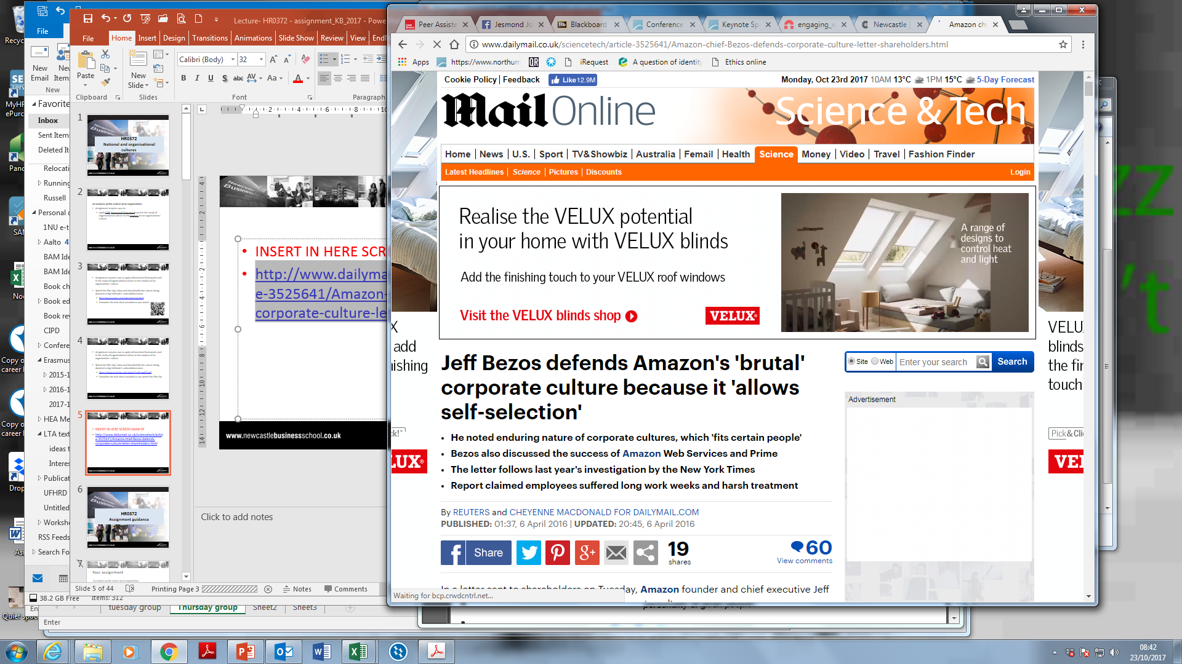

Slide 6
HR0372
Assignment guidance

Slide 7
Assignment task
Your report will apply one theoretical framework used in the study of organisational culture to conduct an analysis of your one selected organisation’s culture

Slide 8
Your report will not exceed 3000 words (excluding appendices or reference list) and should adopt the following format ………

Slide 9
A brief background to the organisation and its environment (10 marks)

Slide 10
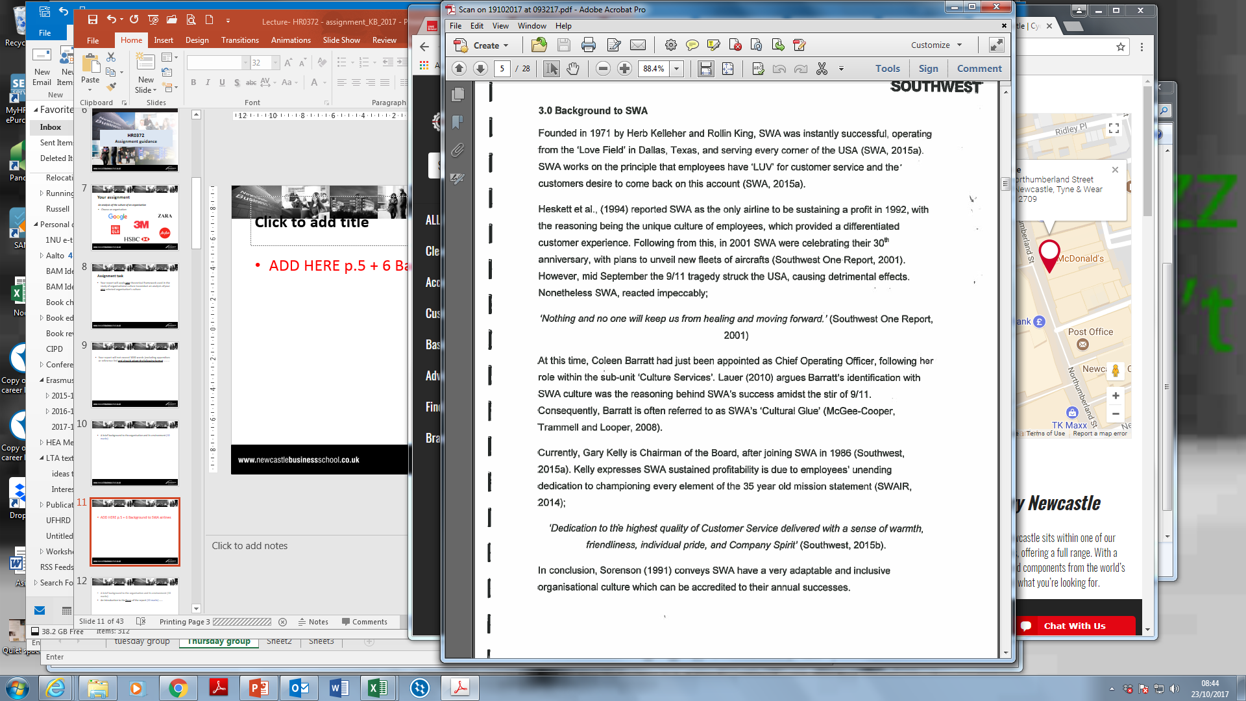
Student example: background to the organisation
>>

Slide 11
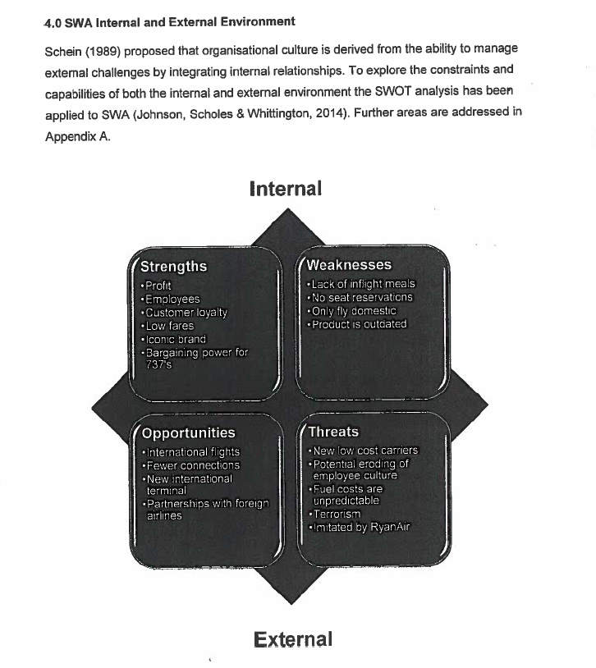
Student example: background (cont.)

Slide 12
A brief background to the organisation and its environment (10 marks)
An Introduction to the focus of the report (10 marks) ……

Slide 13
Focus: The analysis will illustrate the culture by focusing on EITHER
An issue OR
A particular organisational practice OR
An event OR
A sub-unit
………

Slide 14
Focus: Within this section you should include a sentence stating your focus clearly and simply.
For example,
    This report is focused on an analysis of cross cultural management in Nissan after their merger with Renault (Event)
    The analytical focus in this report is on strong culture of DisneyLand in Hong Kong (sub-unit)
    This report is focused on an analysis of leadership practices in Apple and their impact on Organisational Culture (Practice)
    This report focuses on the impact of cultural differences on the failure of DaimlerChrysler merger (Issue)

Slide 15
A student example: Focusing the report
Practices
… Due to this widespread money laundering misconduct, the focus of this report is to analyse to what extent internal organizational cultural factors caused the failures at ‘x’ concerning unethical money laundering conduct.

Slide 16
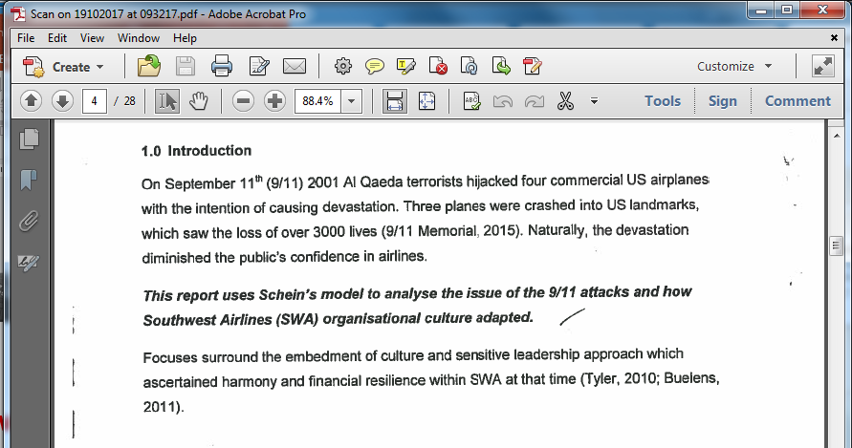
A student example: Focusing the report

Slide 17
A brief background to the organisation and its environment (10 marks)
An Introduction to the focus of the report (10 marks)
A brief argument which explains/justifies why you have chosen a particular theoretical framework instead of ONE other alternative that you considered but have rejected (10 marks)

Slide 18
A student example: stating the framework
In order to develop a persuasive analysis, the author will evaluate the structural formalisation and centralisation on decision making standards within ‘company x’. By doing this, the author aims to assert whether the misconduct occurred as a result of powerful managers or autonomous employees. To analyse the organisational culture of ‘x’ the author will use the Handy/Harrison typologies framework.

Slide 19
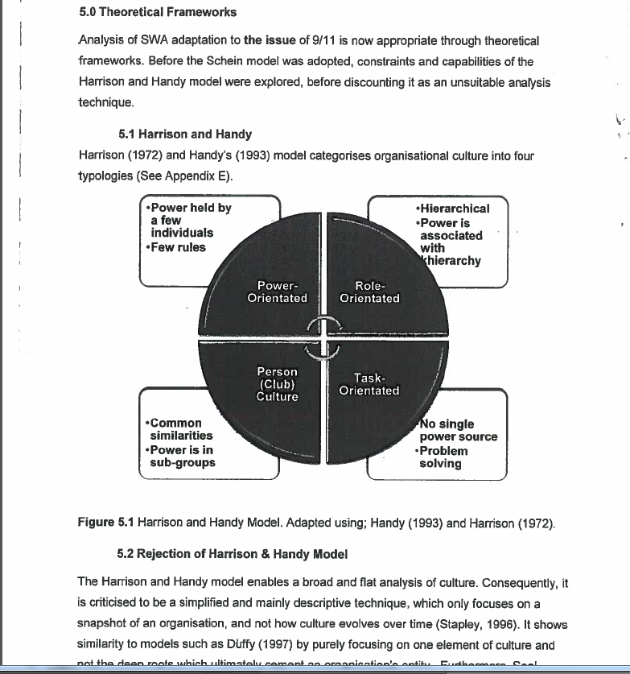
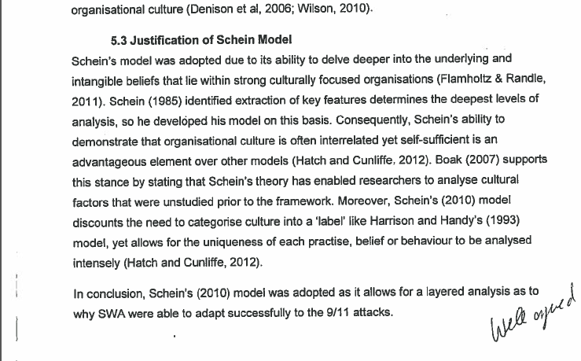
Student example excerpts: the framework

Slide 20
A brief background to the organisation and its environment (10 marks)
An Introduction to the focus of the report (10 marks)
A brief argument which explains/justifies why you have chosen a particular theoretical framework instead of ONE other alternative that you considered but have rejected (10 marks)
An explanation of your chosen theoretical framework that you will use to analyse the organization, including its main concepts (20 marks)

Slide 21
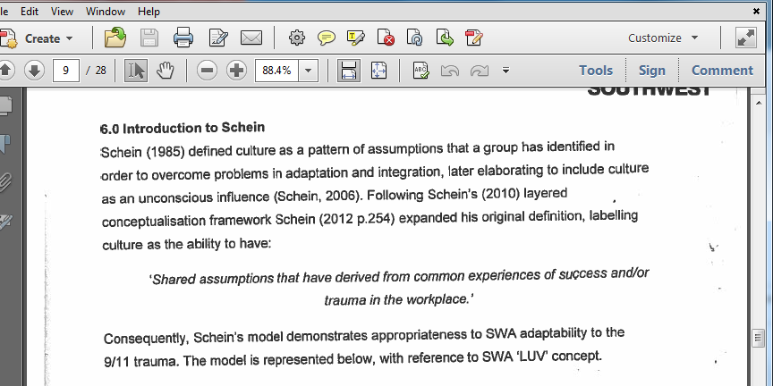
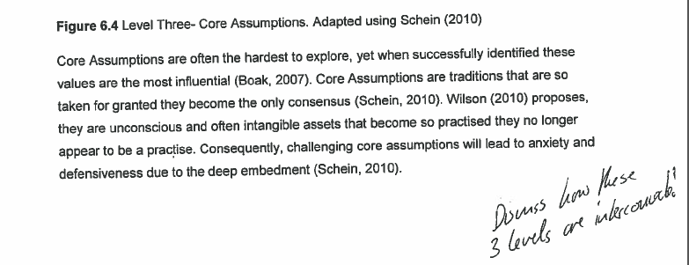
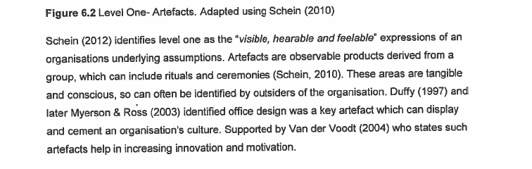
Student example excerpts: explaining the model

Slide 22
A brief background to the organisation and its environment (10 marks)
An Introduction to the focus of the report (10 marks)
A brief argument which explains/justifies why you have chosen a particular theoretical framework instead of ONE other alternative that you considered but have rejected (10 marks)
An explanation of your chosen theoretical framework that you will use to analyse the organization, including its main concepts (20 marks)
An analysis of the practice, issue, event or sub-unit which uses the chosen theoretical framework and concepts (30 marks)

Slide 23
A student example: analysis of the practice
Within this section the author will analyse the organisational culture of ‘company x’ by applying key concepts of Harrison’s/Handy’s framework to the identified practice. To conduct a thorough analysis, each concept will be applied separately followed by a conclusive summary. By doing this, the author aims to identify the most prevalent and least prevalent cultural types.

Slide 24
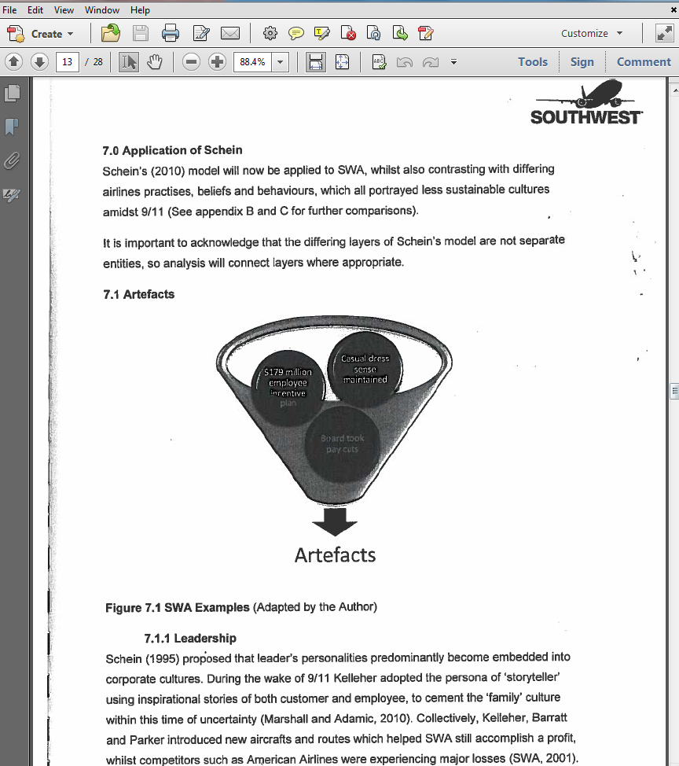
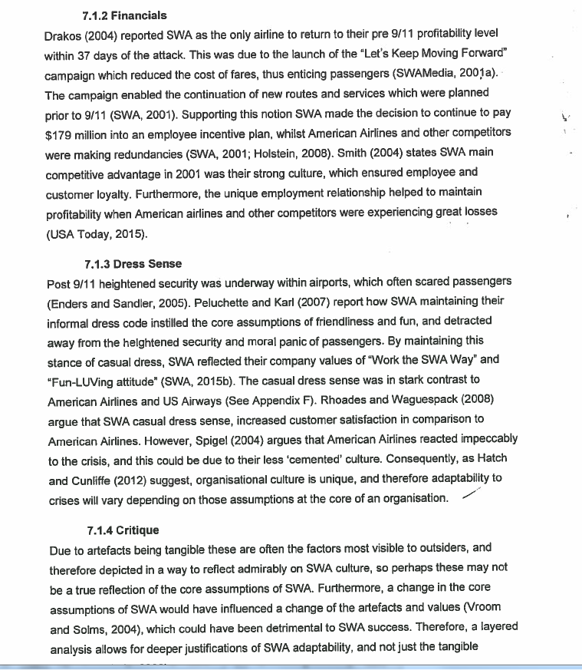
Student example: analysis of the event

Slide 25
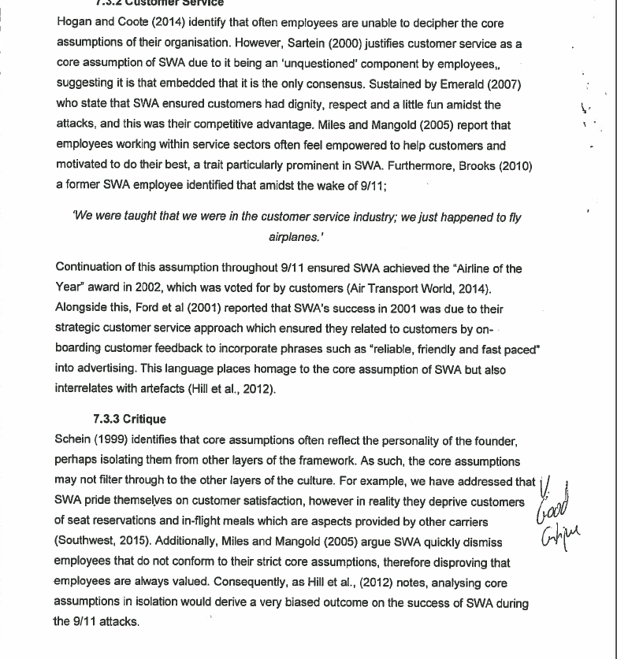
Student example: analysis of the event

Slide 26
A brief background to the organisation and its environment (10 marks)
An Introduction to the focus of the report (10 marks)
A brief argument which explains/justifies why you have chosen a particular theoretical framework instead of ONE other alternative that you considered but have rejected (10 marks)
An explanation of your chosen theoretical framework that you will use to analyse the organization, including its main concepts (20 marks)
An analysis of the practice, issue, event or sub-unit which uses the chosen theoretical framework and concepts (30 marks)
Conclusions (with recommendations if appropriate) (10 marks)

Slide 27
A student example: Conclusions
Despite there being considerable evidence suggesting ‘company x’ has a highly prevalent power culture, there exists evidence and various arguments which suggest ‘company x’ has a prevalent role culture. These include …

Slide 28
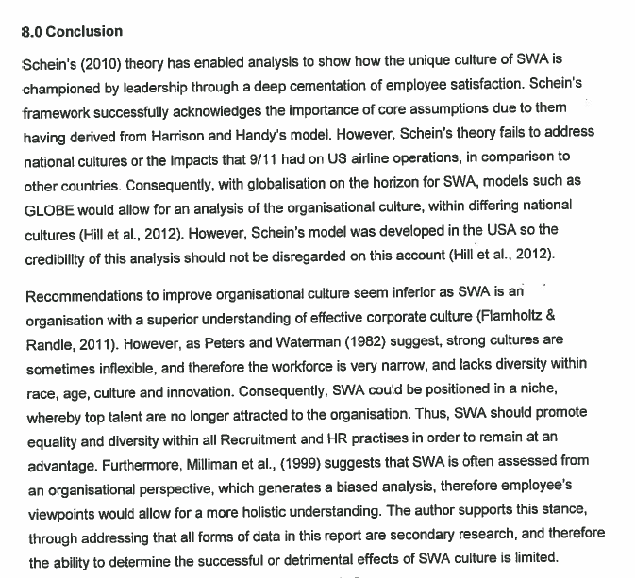
Student example: Conclusions

Slide 29
The final 10 marks will be awarded for structure of the assignment, the quality and credibility of references and correct use of APA referencing

Slide 30
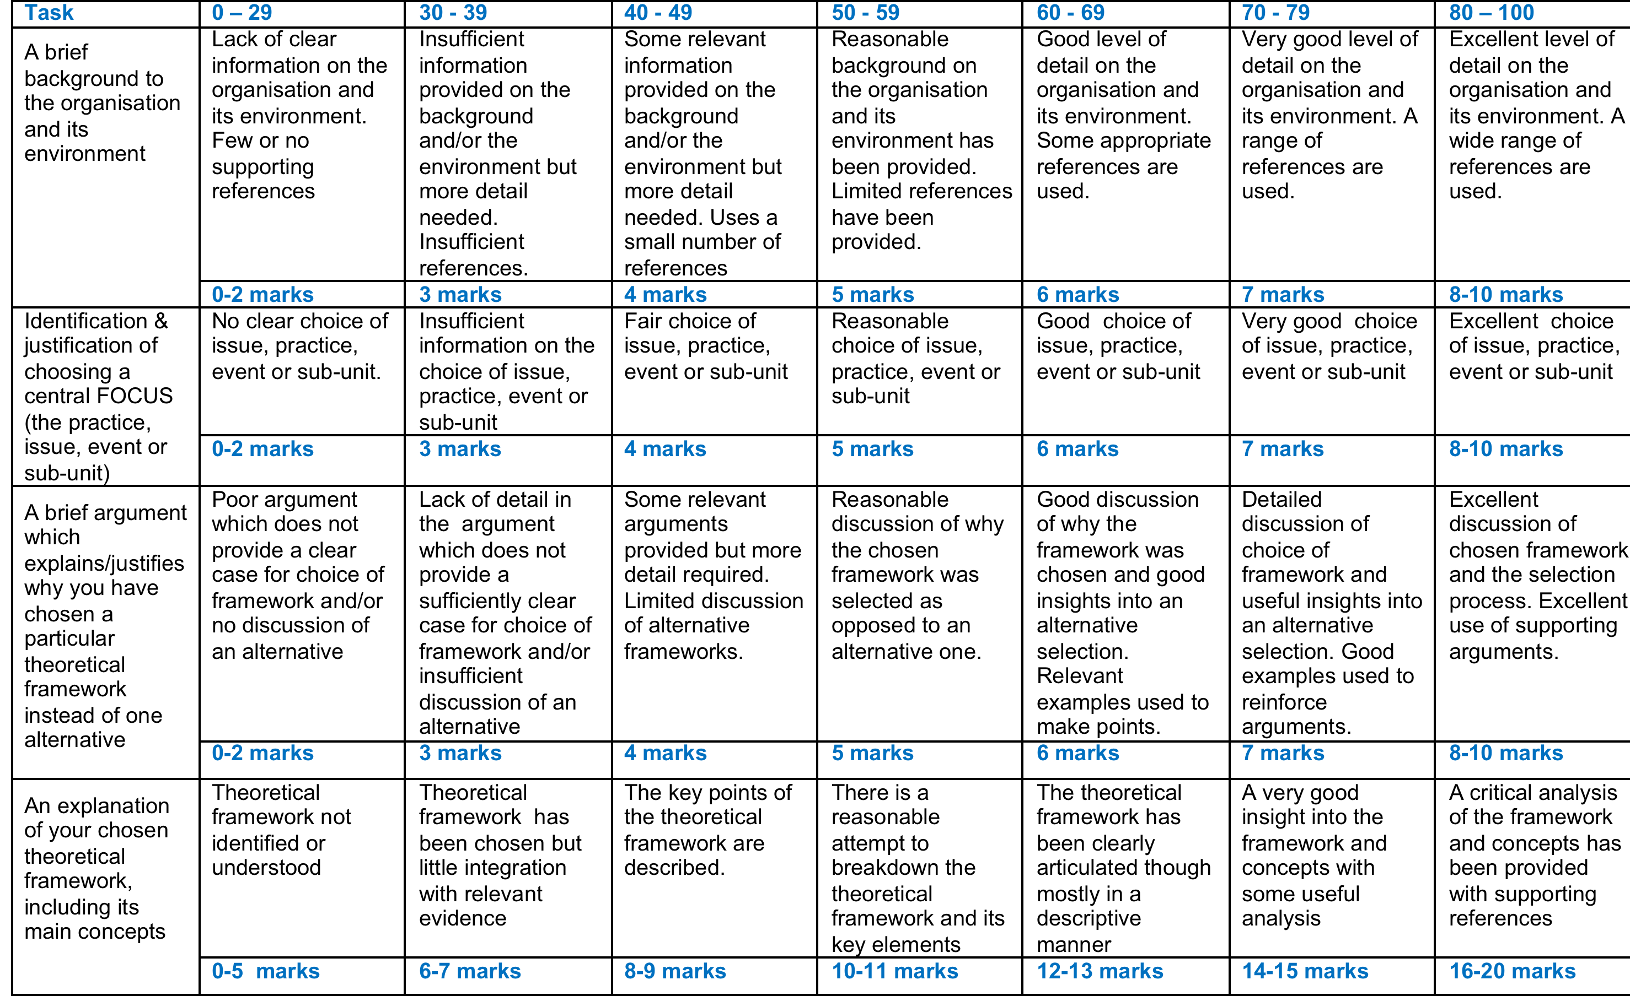
Grading criteria – self assess yourself against this before submission

Slide 31
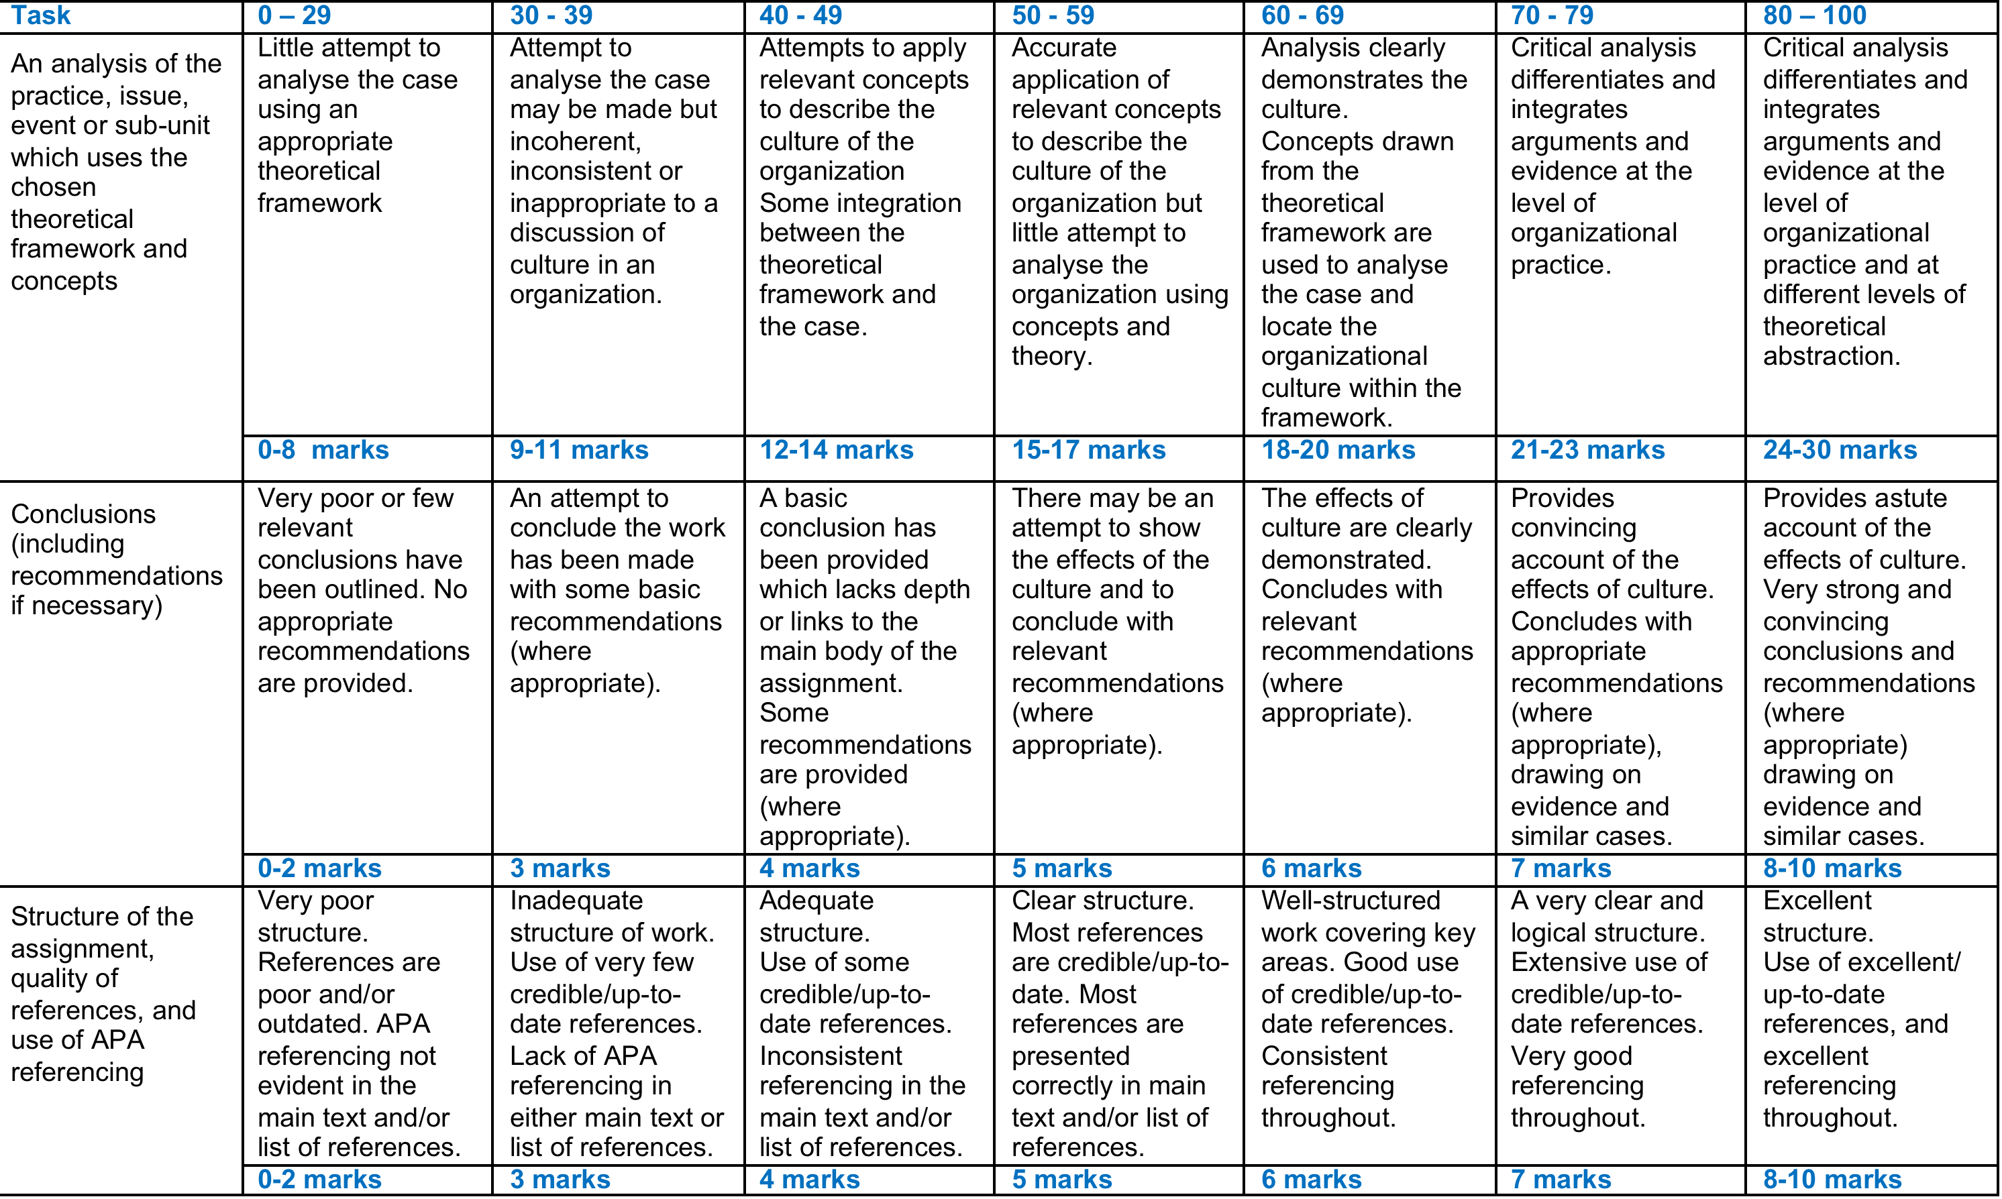
Grading criteria continued

Slide 32
Appropriate references to use within your assignment
Make sure to use
  Journal articles and academic books
  Professional journals and press
    e.g. The Economist, Financial Times, Harvard Business Review
Do NOT use/reference
      popular business / students websites such as BusinessBalls; BizEd; BusinessStudiesOnline; Tutor2u; TopMarks; RevisionStation; BusinessCaseStudies; Tes; RewardLearning; RevisionGuru; Mindtools

Slide 33
A good assignment …..
Has a clear focus:
  Issue, practice, event, sub-unit
Explains the theoretical framework being used
All theories have a focus, those things they attempt to understand, explain and predict
What does the theory argue? What does it attempt to explain?
Outline its central concepts (e.g. Masculinity / Femininity)
Give examples of where it has been used and show how these might compare with your case
  ………

Slide 34
A good assignment …..
Justifies using the theoretical framework
Show your understanding of different theoretical frameworks for understanding culture
Explain why you have chosen a particular framework for this particular focus
Arguments could include the ways in which this framework has been applied to similar cases or the appropriateness to the central focus of your assignment
………

Slide 35
A good assignment ….
Analyses the data/information/issue drawing upon relevant concepts and theory
Theory is applied through its concepts (e.g. ‘Values’ in Schein).
When applying a theory to a case, ensure that you use all of the key concepts within the theory
Identify the particular ways in which these concepts find application in the case (e.g. Hofstede’s ‘individualism’ may be seen in organizational artefacts / rituals / stories)
Provide examples to build your argument about the important values in the culture. Credit will be given for the range of evidence that you use
Having analysed the case through concepts, critically evaluate the culture as a whole by relating the concepts to each other (e.g. Schein’s levels, Hofstede’s dimensions, Handy and Harrison’s cultural types) …….

Slide 36
A good assignment ….
Conclusion
Conclude with an argument about the impact of culture on the organization
  e.g. How might the organization be different if the culture was different?; Has the culture promoted the achievement of the organization’s aims?
Add Recommendations about how the culture might be improved if you think these are appropriate.
Use other cases and examples to illustrate your arguments e.g. What are the similarities and differences between this case and other cases? What could be learned from this?

Slide 37
Getting started
Undertake research on your organisation so that you can develop potential focus on analysis
Develop the focus of the report
Identify the most appropriate framework for your focus question/statement
Undertake research using academic journals

Slide 38
Structuring your assignment
Brief background to the organisation (company ‘x’) selected
Focus of the report
Explanation of applied theoretical frameworks
Justification for framework selection
An analysis of the practice
  Which cultures are prevalent in company ‘x’?
  Organisation culture summary
Conclusions
Reference list (not a bibliography)

Slide 39
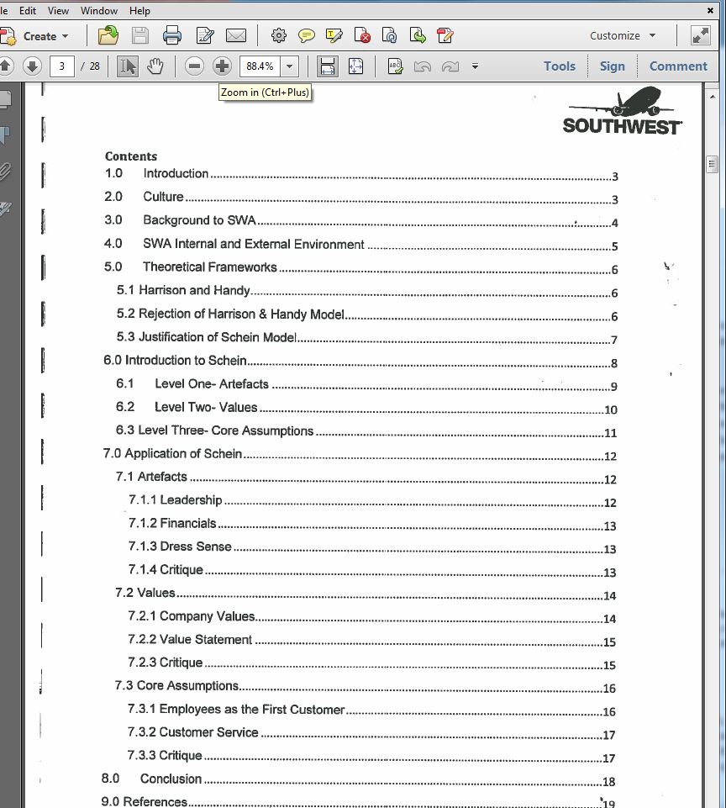
Student example:

Slide 40
Assessment tips
Read the assessment brief carefully … many times!
Review your assessment brief and marking criteria to check you have covered all of the key points … self-assess your work
Ensure that you have cited all of your references correctly (using APA) in the main text … avoiding a risk of plagiarism
Make sure all details are provided in your list of references

